Slide 1
Cryptography and Network Security
Chapter 7
Fifth Edition
by William Stallings
Lecture slides by Lawrie Brown
Notes:
Lecture slides by Lawrie Brown for “Cryptography and Network Security”, 5/e, by William Stallings, Chapter 7 – “Stream Ciphers and Random Number Generation”.

Slide 2
Chapter 7 – Stream Ciphers and Random Number Generation
The comparatively late rise of the theory of probability shows how hard it is to grasp, and the many paradoxes show clearly that we, as humans, lack a well grounded intuition in this matter.
In probability theory there is a great deal of art in setting up the model, in solving the problem, and in applying the results back to the real world actions that will follow.
— The Art of Probability, Richard Hamming
Notes:
Opening quote.

Slide 3
Random Numbers
many uses of random numbers in cryptography
  nonces in authentication protocols to prevent replay
  session keys
  public key generation
  keystream for a one-time pad
in all cases its critical that these values be
  statistically random, uniform distribution, independent
  unpredictability of future values from previous values
true random numbers provide this
care needed with generated random numbers
Notes:
Random numbers play an important role in the use of encryption for various network security applications. In this section, we provide a brief overview of the use of random numbers in cryptography and network security and then focus on the principles of pseudorandom number generation. Getting good random numbers is important, but difficult. You don't want someone guessing the key you're using to protect your communications because your "random numbers" weren't (as happened in an early release of Netscape SSL). Traditionally, the concern in the generation of a sequence of allegedly random numbers has been that the sequence of numbers be random in some well-defined statistical sense (with uniform distribution & independent). In applications such as reciprocal authentication, session key generation, and stream ciphers, the requirement is not just that the sequence of numbers be statistically random but that the successive members of the sequence are unpredictable (so that it is not possible to predict future values having observed previous values). With "true" random sequences, each number is statistically independent of other numbers in the sequence and therefore unpredictable. However, as is discussed shortly, true random numbers are seldom used; rather, sequences of numbers that appear to be random are generated by some algorithm.

Slide 4
Pseudorandom Number Generators (PRNGs)
often use deterministic algorithmic techniques to create “random numbers”
  although are not truly random
  can pass many tests of “randomness”
known as “pseudorandom numbers”
created by “Pseudorandom Number Generators (PRNGs)”
Notes:
Cryptographic applications typically make use of deterministic algorithmic techniques for random number generation, producing sequences of numbers that are not statistically random, but if the algorithm is good, the resulting sequences will pass many reasonable tests of randomness. Such numbers are referred to as pseudorandom numbers, created by “Pseudorandom Number Generators (PRNGs)”.

Slide 5
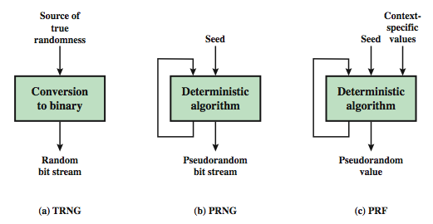
Random & Pseudorandom Number Generators
Notes:
Stallings Figure 7.1 contrasts a true random number generator (TRNG) with two forms of pseudorandom number generators. A TRNG takes as input a source that is effectively random; the source is often referred to as an entropy source. In contrast, a PRNG takes as input a fixed value, called the seed, and produces a sequence of output bits using a deterministic algorithm. Typically, as shown, there is some feedback path by which some of the results of the algorithm are fed back as input as additional output bits are produced. The important thing to note is that the output bit stream is determined solely by the input value or values, so that an adversary who knows the algorithm and the seed can reproduce the entire bit stream.
Figure 7.1 shows two different forms of PRNGs, based on application;
• Pseudorandom number generator: An algorithm that is used to produce an open-ended sequence of bits is referred to as a PRNG. A common application for an open-ended sequence of bits is as input to a symmetric stream cipher, as discussed in Section 7.4. Also, see Figure 3.1a.
• Pseudorandom function (PRF): A PRF is used to produced a pseudorandom string of bits of some fixed length. Examples are the symmetric encryption keys and nonces. Typically, the PRF takes as input a seed plus some context specific values, such as a user ID or an application ID.

Slide 6
PRNG Requirements
randomness
  uniformity, scalability, consistency
unpredictability
  forward & backward unpredictability
  use same tests to check
characteristics of the seed
  secure
  if known adversary can determine output
  so must be random or pseudorandom number
Notes:
When a PRNG or PRF is used for a cryptographic application, then the basic requirement is that an adversary who does not know the seed is unable to determine the pseudorandom string. This general requirement for secrecy of the output of a PRNG or PRF leads to specific requirements in the areas of randomness, unpredictability, and the characteristics of the seed.
In terms of randomness, the requirement for a PRNG is that the generated bit stream appear random even though it is deterministic. NIST SP 800-22 (A Statistical Test Suite for Random and Pseudorandom Number Generators for Cryptographic Applications) specifies that the tests should seek to establish the following three characteristics: uniformity, scalability, consistency. SP 800-22 lists 15 separate tests of randomness.
A stream of pseudorandom numbers should exhibit two forms of unpredictability: forward unpredictability, backward unpredictability. The same set of tests for randomness also provide a test of unpredictability. If the generated bit stream appears random, then it is not possible to predict some bit or bit sequence from knowledge of any previous bits. Similarly, if the bit sequence appears random, then there is no feasible way to deduce the seed based on the bit sequence. That is, a random sequence will have no correlation with a fixed value (the seed).
For cryptographic applications, the seed that serves as input to the PRNG must be secure. Because the PRNG is a deterministic algorithm, if the adversary can deduce the seed, then the output can also be determined. Therefore, the seed must be unpredictable. In fact, the seed itself must be a random or pseudorandom number.

Slide 7
PRNG Requirements
Randomness
  Uniformity – at any point in the generation of the PRN sequence, the occurrence of a zero or a one is equally likely (i.e., p = 0.5)
  Scalability – any test for randomness applicable to a sequence can also be applied to any random subsequence (it should pass)
  Consistency – the characteristics of the PRN sequence of the PRNG must not depend on the seed used
Notes:
When a PRNG or PRF is used for a cryptographic application, then the basic requirement is that an adversary who does not know the seed is unable to determine the pseudorandom string. This general requirement for secrecy of the output of a PRNG or PRF leads to specific requirements in the areas of randomness, unpredictability, and the characteristics of the seed.
In terms of randomness, the requirement for a PRNG is that the generated bit stream appear random even though it is deterministic. NIST SP 800-22 (A Statistical Test Suite for Random and Pseudorandom Number Generators for Cryptographic Applications) specifies that the tests should seek to establish the following three characteristics: uniformity, scalability, consistency. SP 800-22 lists 15 separate tests of randomness.
A stream of pseudorandom numbers should exhibit two forms of unpredictability: forward unpredictability, backward unpredictability. The same set of tests for randomness also provide a test of unpredictability. If the generated bit stream appears random, then it is not possible to predict some bit or bit sequence from knowledge of any previous bits. Similarly, if the bit sequence appears random, then there is no feasible way to deduce the seed based on the bit sequence. That is, a random sequence will have no correlation with a fixed value (the seed).
For cryptographic applications, the seed that serves as input to the PRNG must be secure. Because the PRNG is a deterministic algorithm, if the adversary can deduce the seed, then the output can also be determined. Therefore, the seed must be unpredictable. In fact, the seed itself must be a random or pseudorandom number.

Slide 8
Linear Congruential
Generator
common iterative technique using:
  X_{n+1} = (aX_{n} + c) mod m
given suitable values of parameters can produce a long random-like sequence
suitable criteria to have are:
  function generates a full-period
  generated sequence should appear random
  efficient implementation with 32-bit arithmetic
note that an attacker can reconstruct sequence given a small number of values
have possibilities for making this harder
Notes:
By far the most widely used technique for pseudorandom number generation is the “Linear Congruential Generator”, first proposed by Lehmer. It uses successive values from an iterative equation. Given suitable values of parameters can produce a long random-like sequence, but there are only a small number of such good choices. Note that the sequence, whilst looking random, is highly predictable, and an attacker can reconstruct the sequence knowing only a small number of values. There are some approaches to making this harder to do in practice by modifying the numbers in some way, see text.

Slide 9
Blum Blum Shub Generator
based on public key algorithms
use least significant bit from iterative equation:
  x_{i} = x_{i-1}² mod n
  where n=p.q, and primes p,q=3 mod 4
unpredictable, passes next-bit test
security rests on difficulty of factoring N
is unpredictable given any run of bits
slow, since very large numbers must be used
too slow for cipher use, good for key generation
Notes:
A popular approach to generating secure pseudorandom number is known as the Blum, Blum, Shub (BBS) generator, after its developers [BLUM86]. It has perhaps the strongest public proof of its cryptographic strength of any PRNG. It is based on public key algorithms, and hence is very slow, but has a very high level of security. It is referred to as a cryptographically secure pseudorandom bit generator (CSPRBG), being in practice unpredictable.

Slide 10
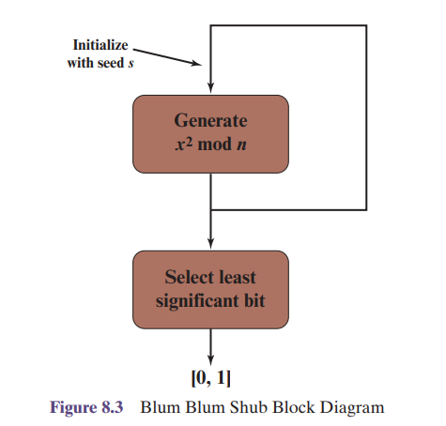

Slide 11
